Slide 1
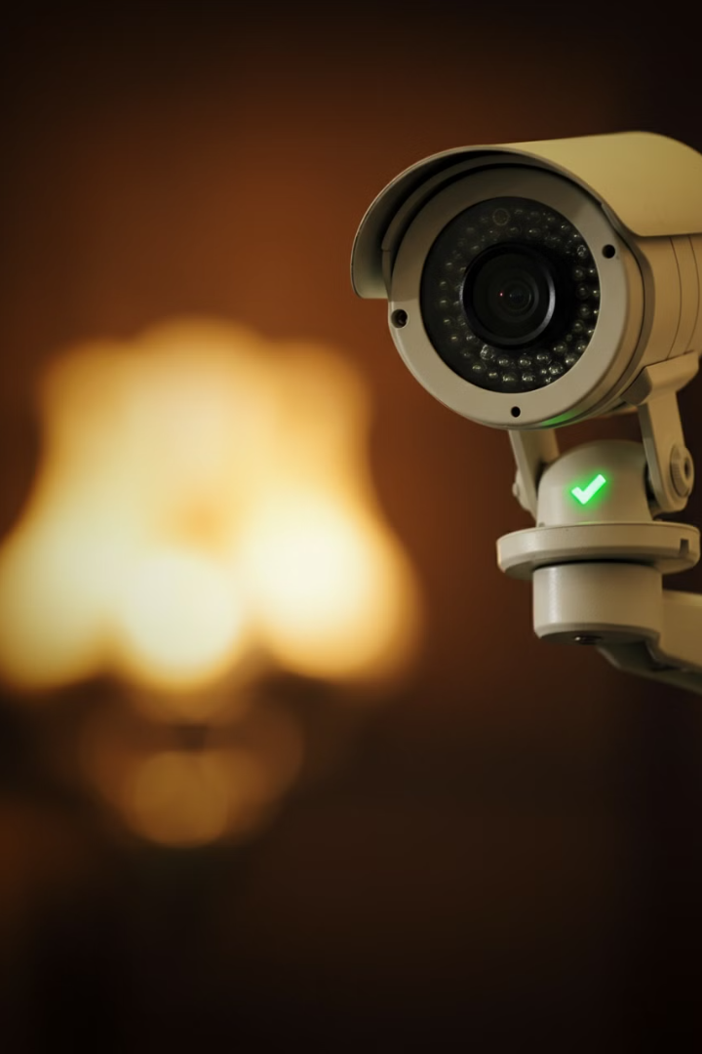
Smart Guard
Project presentation
BACHELOR OF CYBERSECURITY
SUBMITTED BY
Almudaymigh, Abdulrahman
Alwarafi, Osama
SUPERVISED BY
Dr. Khalid-Alyousfi

Slide 2
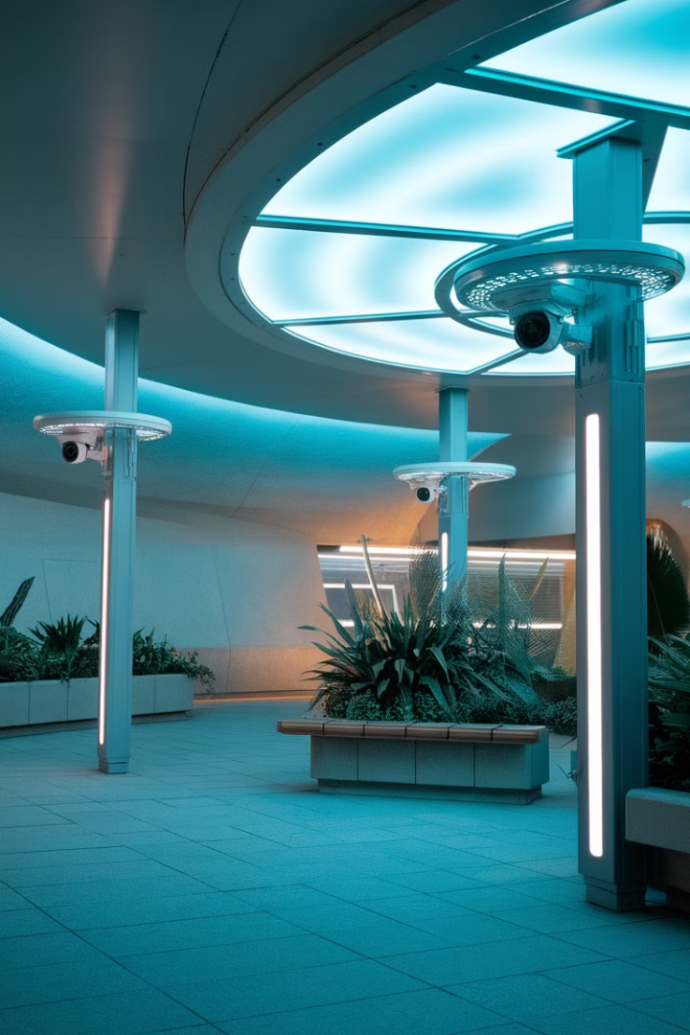
Smart Guard: AI-Powered Security System
Smart Guard is an innovative security system that leverages artificial intelligence and computer vision to detect aggressive behaviors in real-time. This project aims to overcome the limitations of traditional security systems by providing accurate threat detection, immediate notifications, and proper documentation of incidents. Smart Guard enhances safety in various environments including workplaces, schools, hospitals, homes, and public spaces.
AA

Slide 3
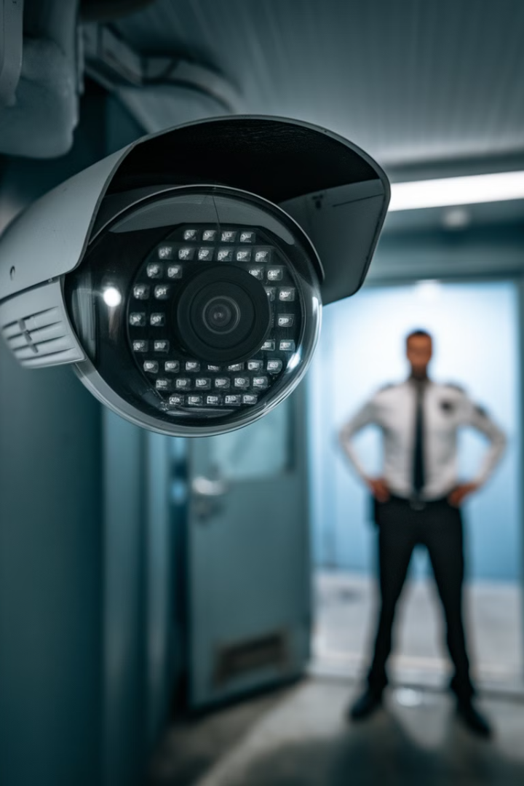
The Problem with Traditional Security Systems
1
lack precision
2
false alarms
Traditional security systems often lack precision and rely on basic motion detection.
They produce frequent false alarms and fail to recognize aggressive behaviors like face-covering, slapping, or punching.
delayed responses
3
Security teams struggle with delayed responses and inadequate documentation of incidents.
Solutions
detect actions
real-time notifications
1
Uses AI and computer vision to detect actions such as slapping, punching, and face-covering.
2
Sends real-time notifications to security personnel via email.
Saves images and logs
3
Automatically captures and saves evidence (images and logs) for post-incident analysis.

Slide 4
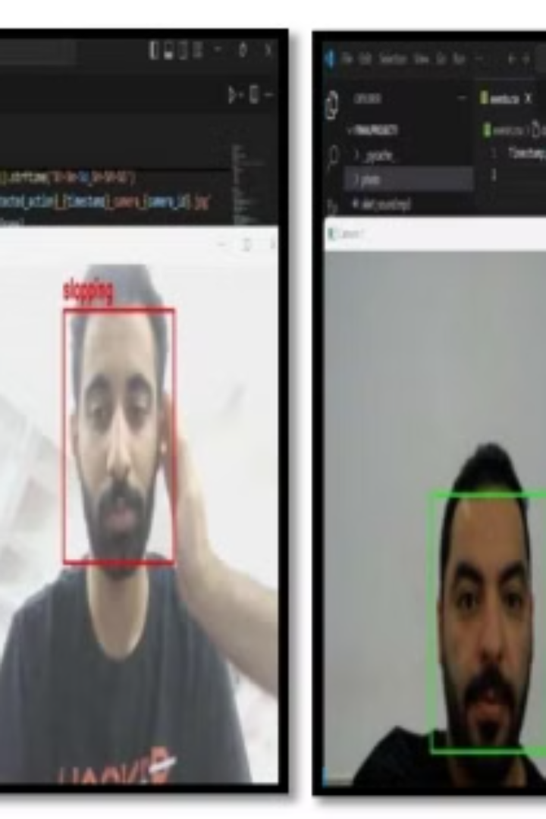
Smart Guard: The AI-Powered Solution
1
AI Analysis
Deep learning algorithms analyze live video feeds from surveillance cameras.
2
Behavior Detection
System identifies aggressive behaviors such as slapping, punching, and face-covering.
3
Immediate Notification
Email alerts are sent to designated personnel upon detection of aggressive behavior.
4
Incident Documentation
Images of events are captured and stored as evidence for further review.

Slide 5
System Applications
Server Rooms and IT Departments
Schools and Hospitals
Homes and Public Spaces
Monitors employee behavior in secure areas, identifying unusual activities that may pose risks to equipment or data integrity.
Enhances safety by detecting aggressive behaviors, providing protection in sensitive environments that require close supervision.
Enables monitoring of visitors or children at home, and crowd behavior in public areas like shopping centers to prevent unwanted actions and ensure safety.

Slide 6
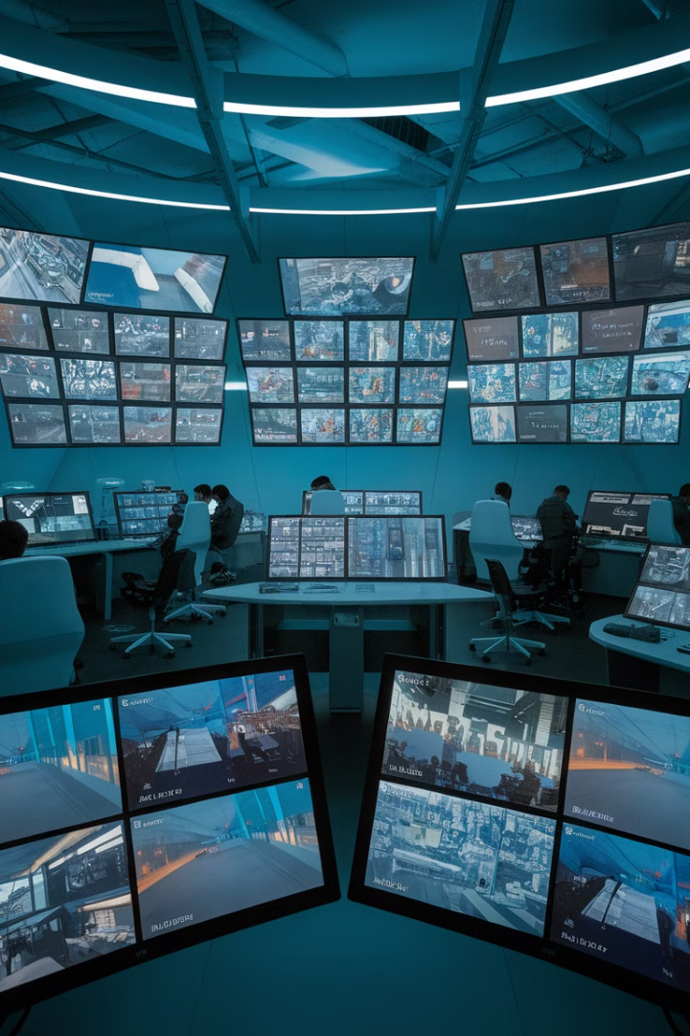
Project Objective
Upgrade Security
Accurate Identification
Incorporate AI to move beyond simple motion detection in traditional security frameworks.
Enable precise detection of aggressive behaviors such as face-covering, slapping, and punching.
Immediate Alerts
Facilitate timely responses through instant notifications upon detection of aggressive behavior.

Slide 7
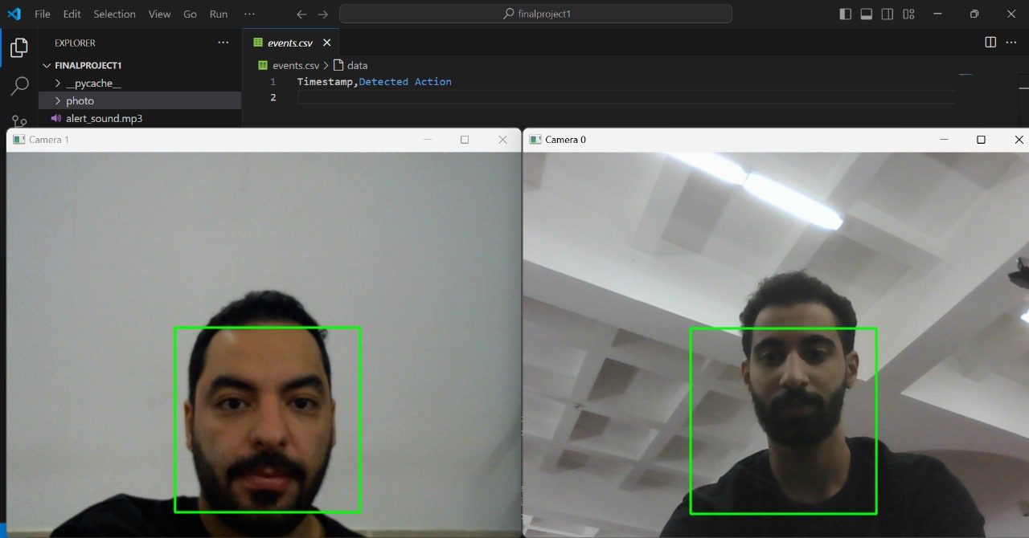
Colored Frame Model
for Behavior Detection
The Smart Guard system utilizes a color-coded framing model to
visually indicate the detection of aggressive behavior.
Initially, individuals are framed in green, signifying normal behavior.
When aggressive behavior is detected, the frame changes to red, and
the type of behavior is displayed above the frame.
This visual cue allows for quick identification of potential threats.

Slide 8
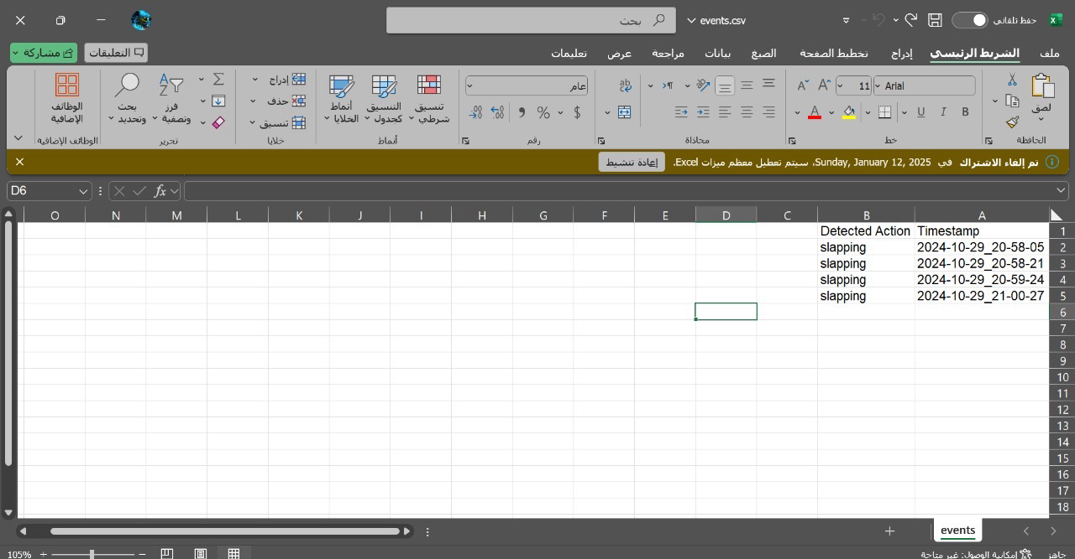




Incident Logging and Documentation
Behavior Detection
System identifies aggressive behavior in real-time.
CSV Logging
Incident details are recorded in a CSV file, including behavior type and timestamp.
Image Capture
System captures and stores images of the aggressive event.
Email Notification
Alerts are sent to designated personnel with incident details.

Slide 9
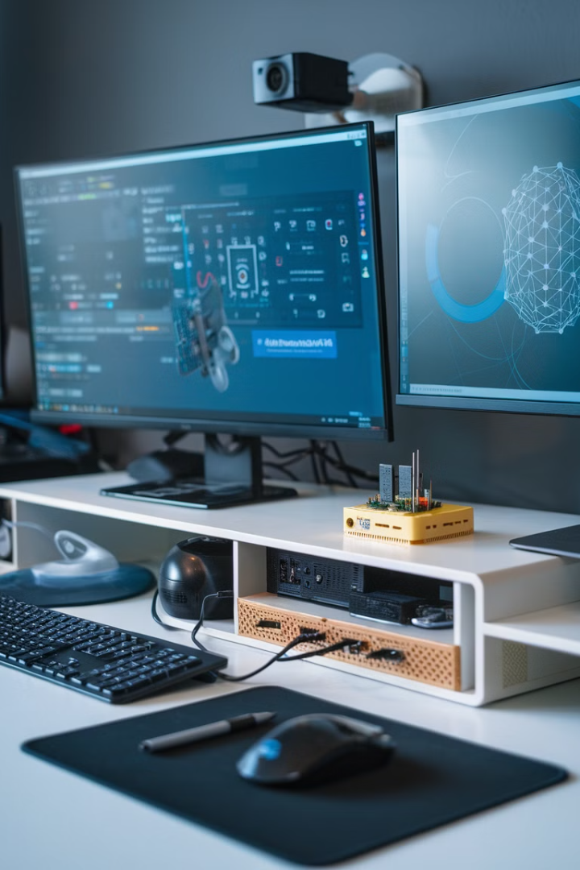




Tools and Technologies
Raspberry Pi
Computer
Main processing unit for analysis and system tasks.
Enhances processing capabilities for complex computations.
Camera
TensorFlow
Captures video footage for processing and analysis.
Deep learning framework for model training and evaluation.

Slide 10
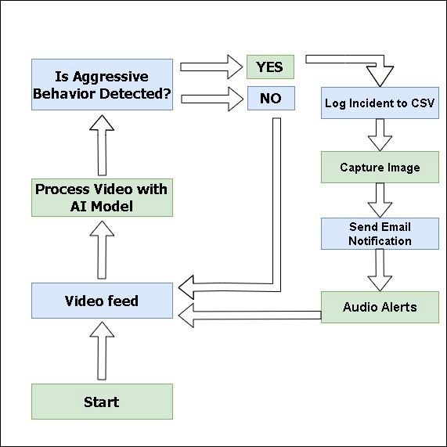
System Workflow
The Smart Guard system follows a structured workflow to detect and monitor aggressive behavior. It begins with a camera capturing the scene and sending data to the project code for analysis. If aggressive activity is detected and confirmed, an email alert is sent to the security team for appropriate action. This streamlined process ensures efficient and timely responses to potential threats.

Slide 11
Project Stages
Model Selection
1
Researched and selected the I3D model for detecting aggressive behavior.
2
Incident Logging
Developed code to log detected incidents in a CSV file.
Image Capture
3
Created code to save images of aggressive events.
4
Color-Coded Framing
Implemented a system to visually indicate detected behaviors.
Audio Alerts
5
Integrated audio warnings for detected aggressive behavior.
6
Email Notifications
Configured immediate email alerts for detected actions.
System Testing
7
Rigorously tested the system with new data to ensure accuracy.

Slide 12

Challenges
Limited processing power of Raspberry Pi
False positives in behavior detection
Delays in real-time alerting

Slide 13
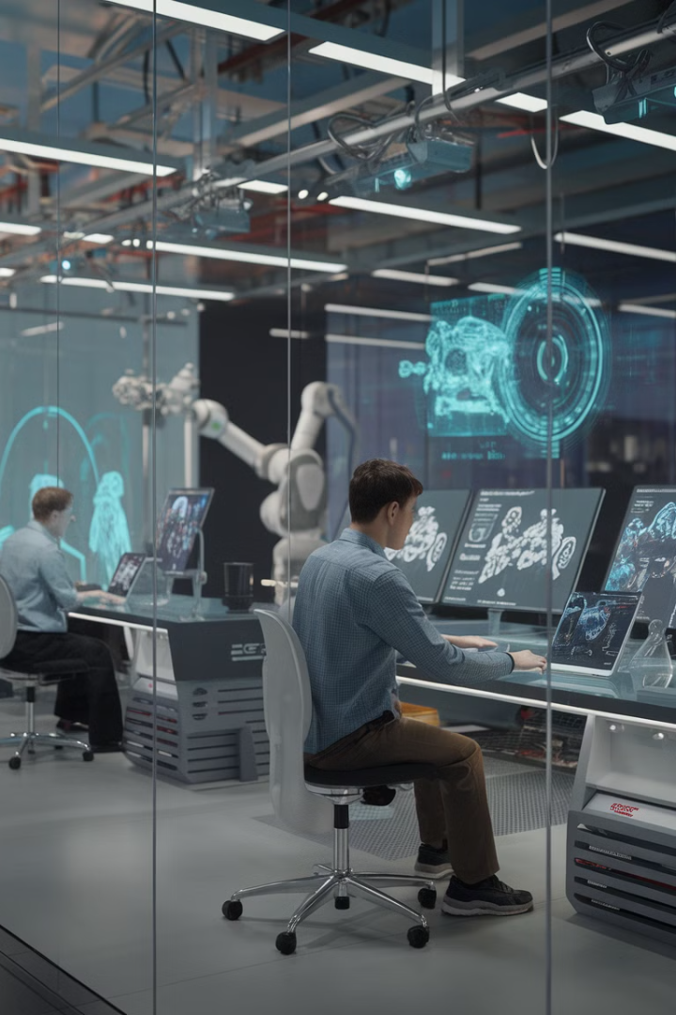
Development Opportunities
1
Enhanced Accuracy
2
Expanded Behavior Library
Incorporate more training data to improve detection accuracy for various aggressive behaviors.
Add more behaviors, such as pushing or throwing objects, to broaden the system's scope.
3
High-Quality Camera Support
4
Integrated Alarm System
Integrate high-resolution cameras to enhance detection capabilities, particularly in low-light scenarios.
Link the system with alarms to initiate audio alerts or emergency calls upon detecting aggression.

Slide 14
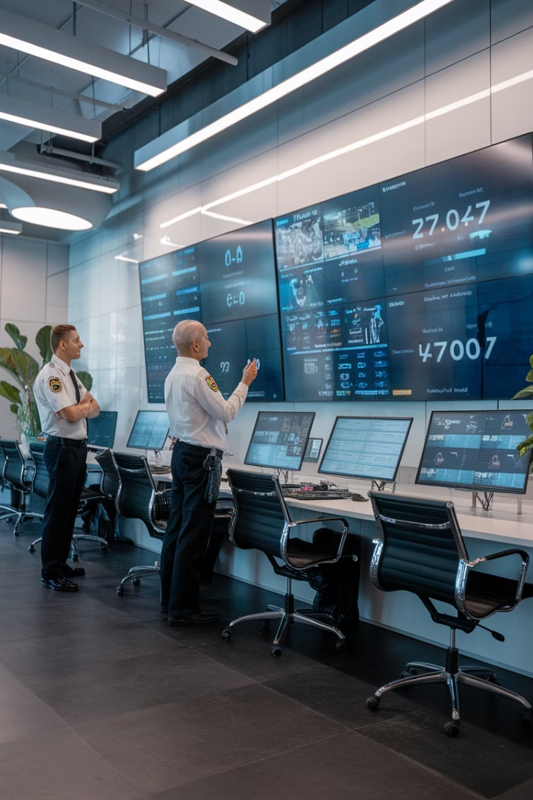
Conclusion and Results
The Smart Guard project successfully demonstrated real-time detection of aggressive behaviors with satisfactory accuracy. The system effectively sends immediate email notifications and saves video evidence upon detecting suspicious actions. Despite challenges in optimizing performance and improving detection accuracy, Smart Guard has proven its efficacy in enhancing safety across various environments.
With future enhancements, including expanded behavior libraries and integration with advanced notification systems, Smart Guard is poised to address evolving security needs effectively.

Slide 15





References and Resources
I3D Action Recognition Model
GitHub repository for the core model used in Smart Guard.
TensorFlow
End-to-End Open Source Machine Learning Platform.
OpenCV
Open Source Computer Vision Library used for behavior identification.
Flask
Web framework used for creating the system's interface.
SMTP Library
Used for implementing email notifications in the system.

